Slide 1





Using mobility and social network data to predict and prevent future pandemics
Mark Lurie, PhD
MAPPS PI
Associate Professor of Epidemiology
Interim Director, International Health Institute

Slide 2


Slide 3
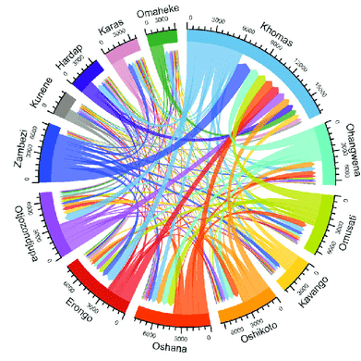

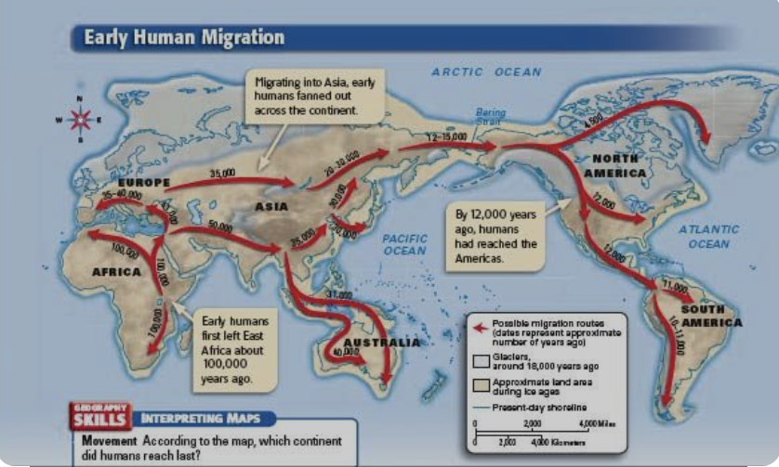
Why Study Mobility and Social Mixing?

Slide 4
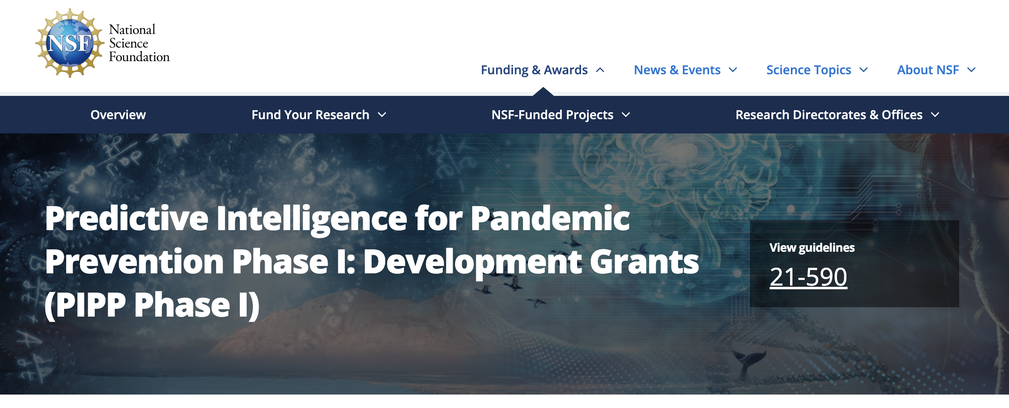
Notes:
That exactly what the NSF asked us to do when they put out this call for applications nearly 2 years ago
Recognising that COVID will not be the last pandemic we face – there will of course be more – the NSF devised PIPP, a new program aimed to fund centers that focus on predicting and preventing future pandemics. This is an opportunity NSF gave us when they asked for 5-10 year visions for scientific discoveries on the horizon, methodologies, technologies that we could begin to understand and harness now so that one day they might be able to be more readily deployed, potentially even in real time

Slide 5
MAPPS: Central, simple premise
Infectious disease follows the movement of people
Understanding how humans interact and move through space and time is therefore fundamental to how disease spread through populations
If we know who interacts with who and under what circumstances, we could potentially implement targeted interventions that slow or eliminate spread

Slide 6
Epidemiological lens R₀ the Basic Reproductive Number
R₀
Important measure of epidemic potential
Answers the question: on average, how many new infections will a primary case produce when introduced into a totally susceptible population
R₀ > 1 means continued spread
R₀ < 1 epidemic dies out

Slide 7
The Basic Reproductive Number:
How Fast Will An Epidemic Grow?
R₀ = D * C * β
Mean length of time infectious
(Duration of infectivity)
Likelihood of transmission on any contact
(Transmission Probability)
Rate at which infected people have contact with uninfected people
(Contact Patterns/Networks)

Slide 8
Rationale for MAPPS
Main components of MAPPS
Brief overview of MAPPING@Brown Project
Overview and structure of the workshop
Outline

Slide 9
MAPPS Project Components

Slide 10
Our grand challenge:
How can we best measure and use human mobility and population mixing data to inform real-time pandemic responses across a range of pathogens and under conditions of uncertainty while balancing benefits, risks and harms?

Slide 11
Data
Device
Modeling and Prediction
Ethics, privacy, confidentiality

Slide 12
Data
Collect, catalogue and make publicly available data on human mobility and social mixing
Federated database; data protections
Data clearinghouse for pandemic researchers

Slide 13
Develop new technologies for measuring mobility, social interactions and biometrics
wearables, phone apps
Develop methodologies for analysing and using “passive” surveillance data
Swipe cards, wifi login
Device

Slide 14
Modeling and Prediction
To use data from our devices and library of studies to model the impact of new pathogens spreading through a network and to identify potential interventions that could slow disease spread

Slide 15
To infuse our work with a strong ethical foundation, addressing issues of privacy and confidentiality
To think critically and educate the Brown community about big data, privacy and confidentiality
To develop MAPPS ethics primer, a Q and A addressing likely ethical concerns of app users
Ethics, privacy, confidentiality

Slide 16
Data
Device
Modeling and Prediction
Ethics, privacy, confidentiality

Slide 17
Data
Device
MAPPING@Brown
Modeling and Prediction
Ethics, privacy, confidentiality

Slide 18

MAPPING@Brown: Main Goals
Measure the social network at Brown University
Use the social network data to populate flexible and realistic mathematical models of disease transmission
Intervention assessment: Explore transmission dynamics under different scenarios of social mixing and mobility
Simulation exercise
Introduce a virtual pathogen with specific epidemiological characteristics into the network and observe spread through the network
Identify point of intervention/changes in social mixing that would be effective at elimination or containment of the virtual pathogen
Notes:
Imagine if our app was functional and we all downloaded it before the workshop. The app would measure the proximity of each of us to one another, some aspects of the room/environment and about how long we interact with each other. Then we each move in different directions, some have meetings up the hill others go elsewhere – the point is that a fully functioning app can track and measure all for that, giving us exquisitely detailed information about the social network and – importantly - how it changes over time.
We could then use the social networking data we gather to populate our mathematical models so that they can make best use of social mixing data to predict and prevent new pandemics.
At the same time, the app and the data we collect offer an opportunity to run different epidemic simulations – either during or after the use of the app for data collection.
We can then simulate the introduction of a (virtual) pathogen – we can assign it the epidemiological characteristics that we want - say transmission happens 20% of the time when 2 people are within 6 feet of each other for more than 15 minutes - in the Brown community and observe how it spreads given what we know about the social network. That also allows us to examine whether and which interventions aimed at changing social interactions will impact on epidemic dynamic sand spread through our population.

Slide 19
MAPPING@Brown: Overarching, proof-of-concept study
18-month goals:
Device development
Deep community engagement
Pilot in Brown School of Public Health in AY 2022/23
5-year goal:
To map the entire social network at Brown (!)
5-10 year goal
Add biometrics and other measurements;
Discover wider applications
Notes:
Ambitious but we are building systematically towards each phase

Slide 20
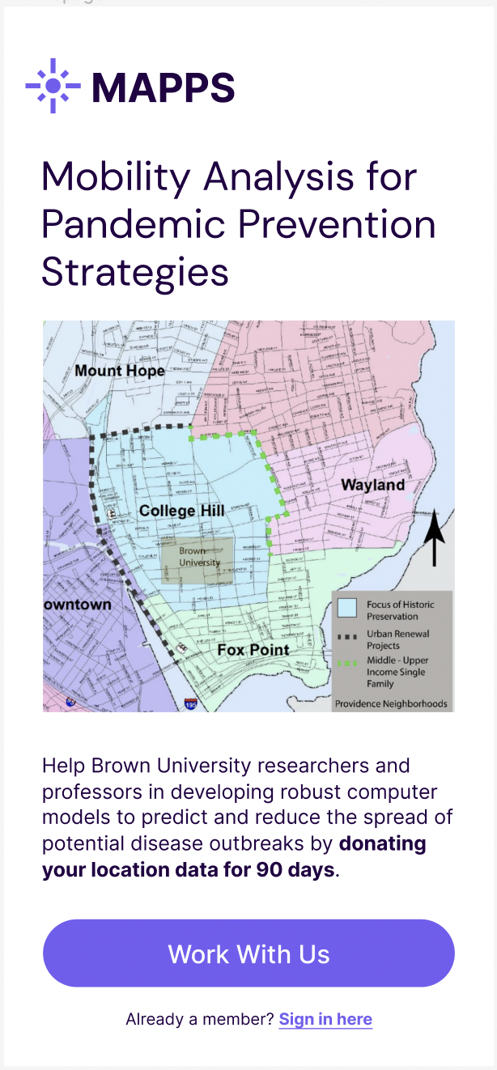
MAPPING@Brown
More to come about this in the breakout sessions!

Slide 21
Data
Device
MAPPING@Brown
Modeling and Prediction
Ethics, privacy, confidentiality

Slide 22
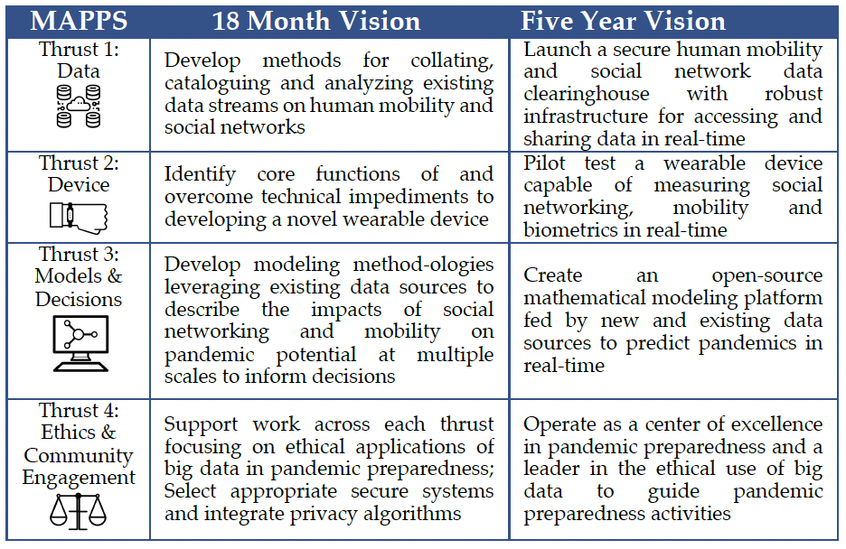
MAPPS 18-month and 5-year goals

Slide 23
NSF PIPP Phase 2
RFA not yet released
Approximately 7 years and $20-25 million

Slide 24
Workshop Purpose & Structure

Slide 25
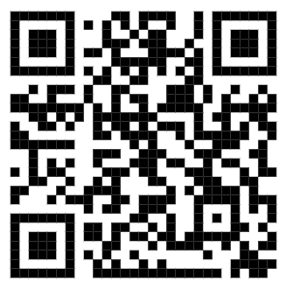
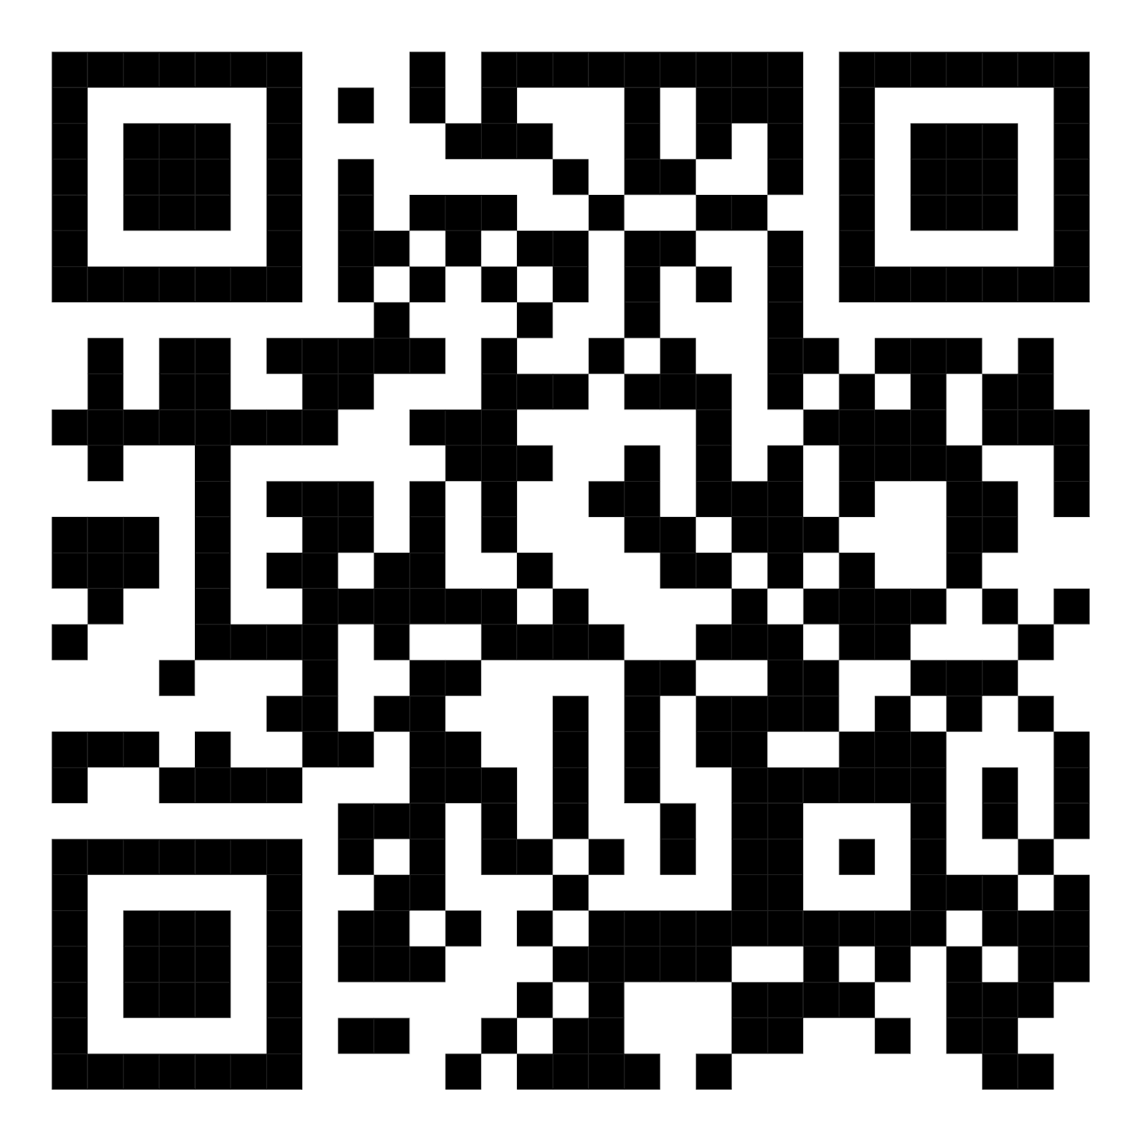
Privacy and Ethics in Pandemic Data Collection and Processing Websites
Workshop Website
https://mapps-brown.github.io/workshop2023/
The workshop materials can be found here. We will post materials to this website throughout the week.
ICERM Website
https://icerm.brown.edu/topical_workshops/tw-23-pep/
The daily agenda will be posted here, and ICERM will live stream the keynotes each day.

Slide 26
Purpose
Develop a framework for state of the art privacy and ethics protection in the context of pandemic data collection and processing;
Develop protocol for MAPPING@Brown exercise;
Develop new collaborations for Phase 2 PIPP Application.

Slide 27
Desired Outcomes
Data: Prioritized list of data needs for measuring movement and social mixing during MAPPING@Brown
Privacy and Ethics: Concrete approaches to managing the ethical issues that arise from collecting, managing, analyzing, and sharing human mobility and social mixing data
Technical Execution: Outline the technical approaches to responsible use of shared data
Modeling: Outline modeling and simulation scenarios using MAPPING@Brown data to facilitate optimal prediction and prevention of future pandemics
Data Sharing: Identify techniques for ethically using multi-party computation to analyze mobility and social mixing datasets from multiple institutions at once
Notes:
How can we best measure and use human mobility and population mixing data to inform real-time pandemic responses across a range of pathogens and under conditions of uncertainty while balancing benefits, risks and harms?
Outline of best practices in data collection and modeling of pandemics;
Generate practical approaches to address data privacy and ethics;
Design the technical approaches to data collection (including device functionality and user experience, variable measurements, data needs, data protection);
Outline frameworks for incorporating data and modeling human interaction and mobility into epidemic simulations;
Identify and nurture new collaborations

Slide 28
Structure
Distinguished keynote speakers;
Breakout sessions in which we ask for your input in the design, ethics, implementation and analysis of MAPPING@Brown
Small, focused, interdisciplinary and participatory;
Plenty of time for discussions
Lots of unstructured time
These walls can speak

Slide 29
Data collection
Ethical concerns
Privacy protection
Simulation design
Data storage & collaboration
Breakout Sessions
Focus on MAPPING@Brown exercise
Solving specific ethical, technical and analytical issues
arising in MAPPING@Brown exercise

Slide 30
Data collection
Ethical concerns
Privacy protection
Simulation design
Data storage & collaboration
Breakout Sessions
Focus on MAPPING@Brown exercise

Slide 31
Breakout 1
What data will we collect during MAPPING@Brown in order to map mobility and social mixing patterns within the Brown community? How and how often might these data be collected?
Data collection
Tuesday, 3:00-4:30 PM
Led by Mark Lurie

Slide 32
Breakout 2
How might we approach the ethical issues that arise from collecting, managing, analyzing, and sharing the types of data identified in Breakout 1?
Ethical concerns
Wednesday, 1:15-2:45 PM
Led by Julia Netter

Slide 33
Breakout 3
How can we protect participants’ right to privacy on a technical level using cryptographic approaches like differential privacy, which guide what questions we can ask of our data without risking reidentification or other harms?
Privacy protection
Wednesday, 3:15-4:45 PM
Led by Anna Lysyanskaya

Slide 34
Breakout 4
How do we make best use of he social network data we will gather in MAPPING@Brown and what can we use that to advance network science?
What is the optimal design of an embedded outbreak simulation using MAPPING@Brown data to inform our efforts to predict and prevent future pandemics?
Simulation design & analysis
Thursday, 10:30-12:00 PM
Led by Thomas Trikalinos, Jason Gantenberg, and Aditya Khanna

Slide 35
Breakout 5
How can we use multi-party computation to enable researchers to analyze MAPPING@Brown-type datasets from multiple institutions in conjunction?
Data storage & collaboration
Thursday, 3:15-4:45 PM
Led by Anna Lysyanskaya

Slide 36
Data collection
Ethical concerns
Privacy protection
Simulation design & analysis
Data storage & collaboration
MAPPING@Brown Breakouts

Slide 37
The MAPPS Team

Slide 38
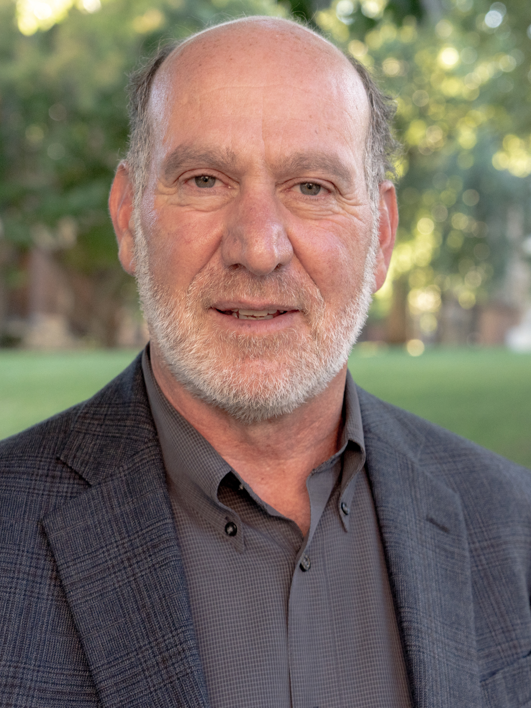
MAPPS Team: Principal investigator
Mark Lurie, PhD
Associate Professor of Epidemiology;
Interim Director, International Health Institute

Slide 39
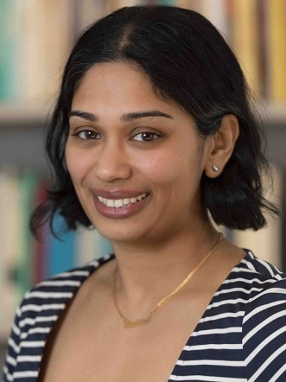
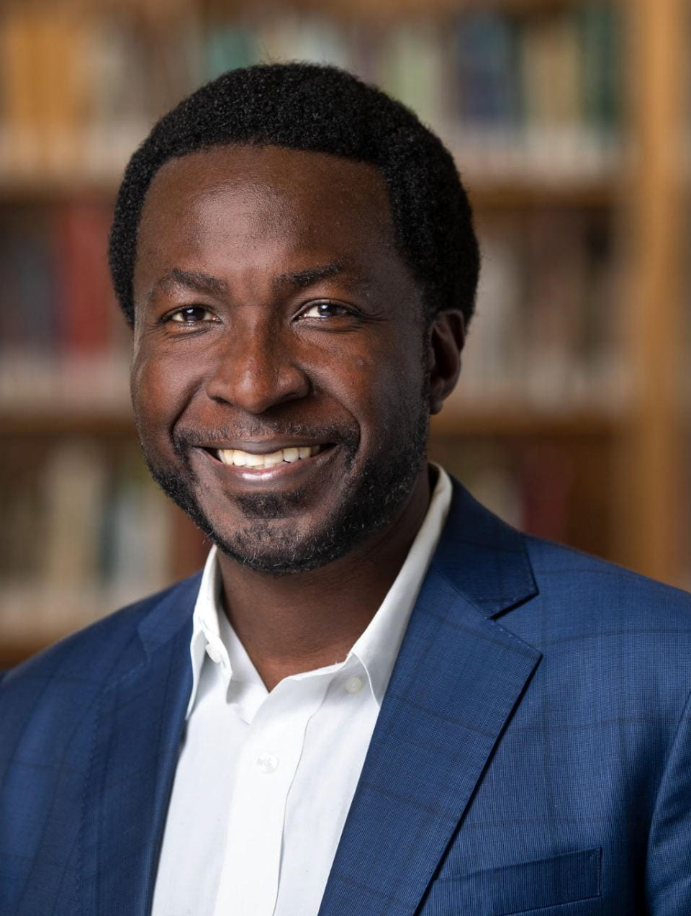
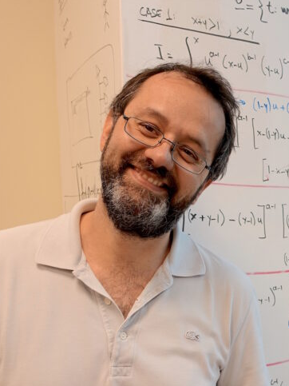
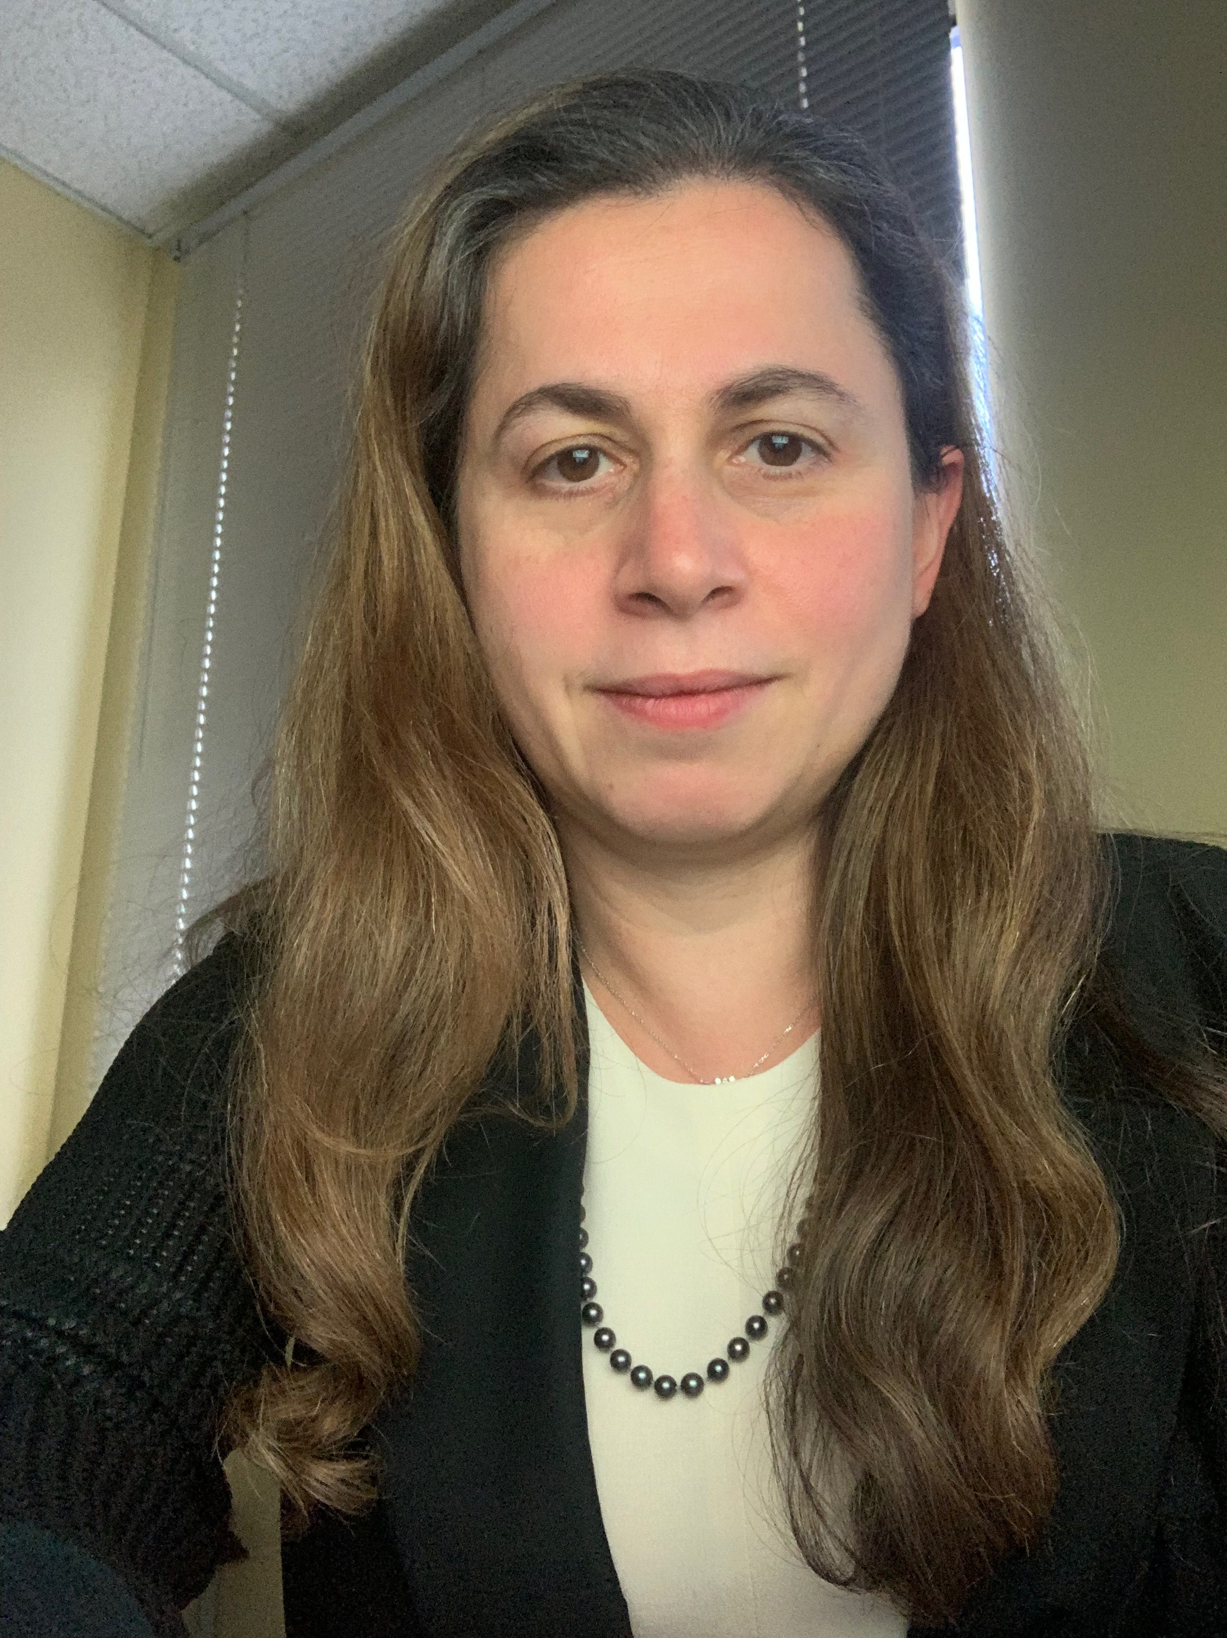
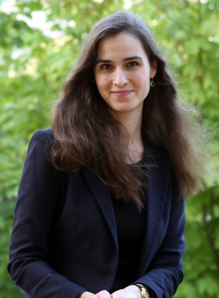
MAPPS Team: Co-Investigators
Sohini Ramachandran, PhD
Professor of Ecology, Evolution, and Organismal
Biology; Director, Data Science Initiative
Kimani Toussaint, PhD
Professor of Engineering; Senior Associate Dean of Engineering
Thomas Trikalinos, PhD
Professor of Health Services, Policy and Practice and Biostatistics; Director: Center for Evidence Bases Synthesis in Health
Anna Lysyanskaya, PhD
Professor of Computer Science
Julia Netter, DPhil
Visiting Assistant Professor of Philosophy;
Coordinator: Social Responsible Computing Program

Slide 40
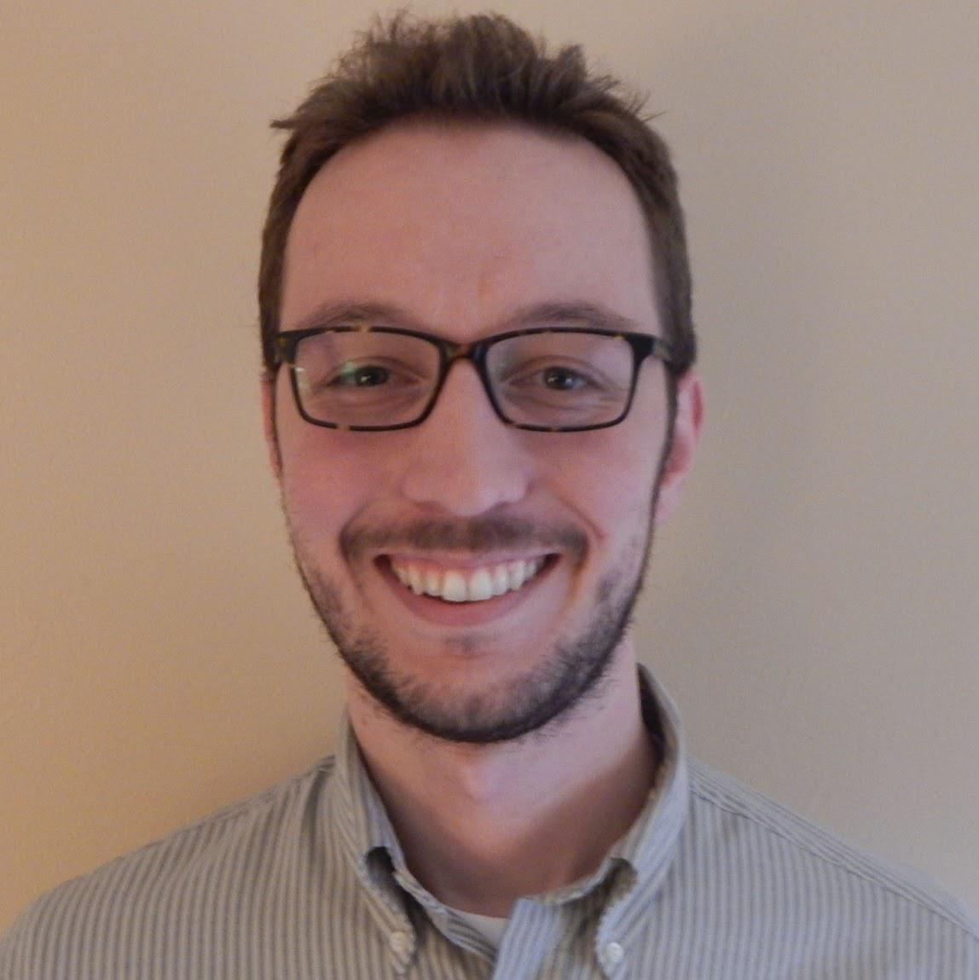
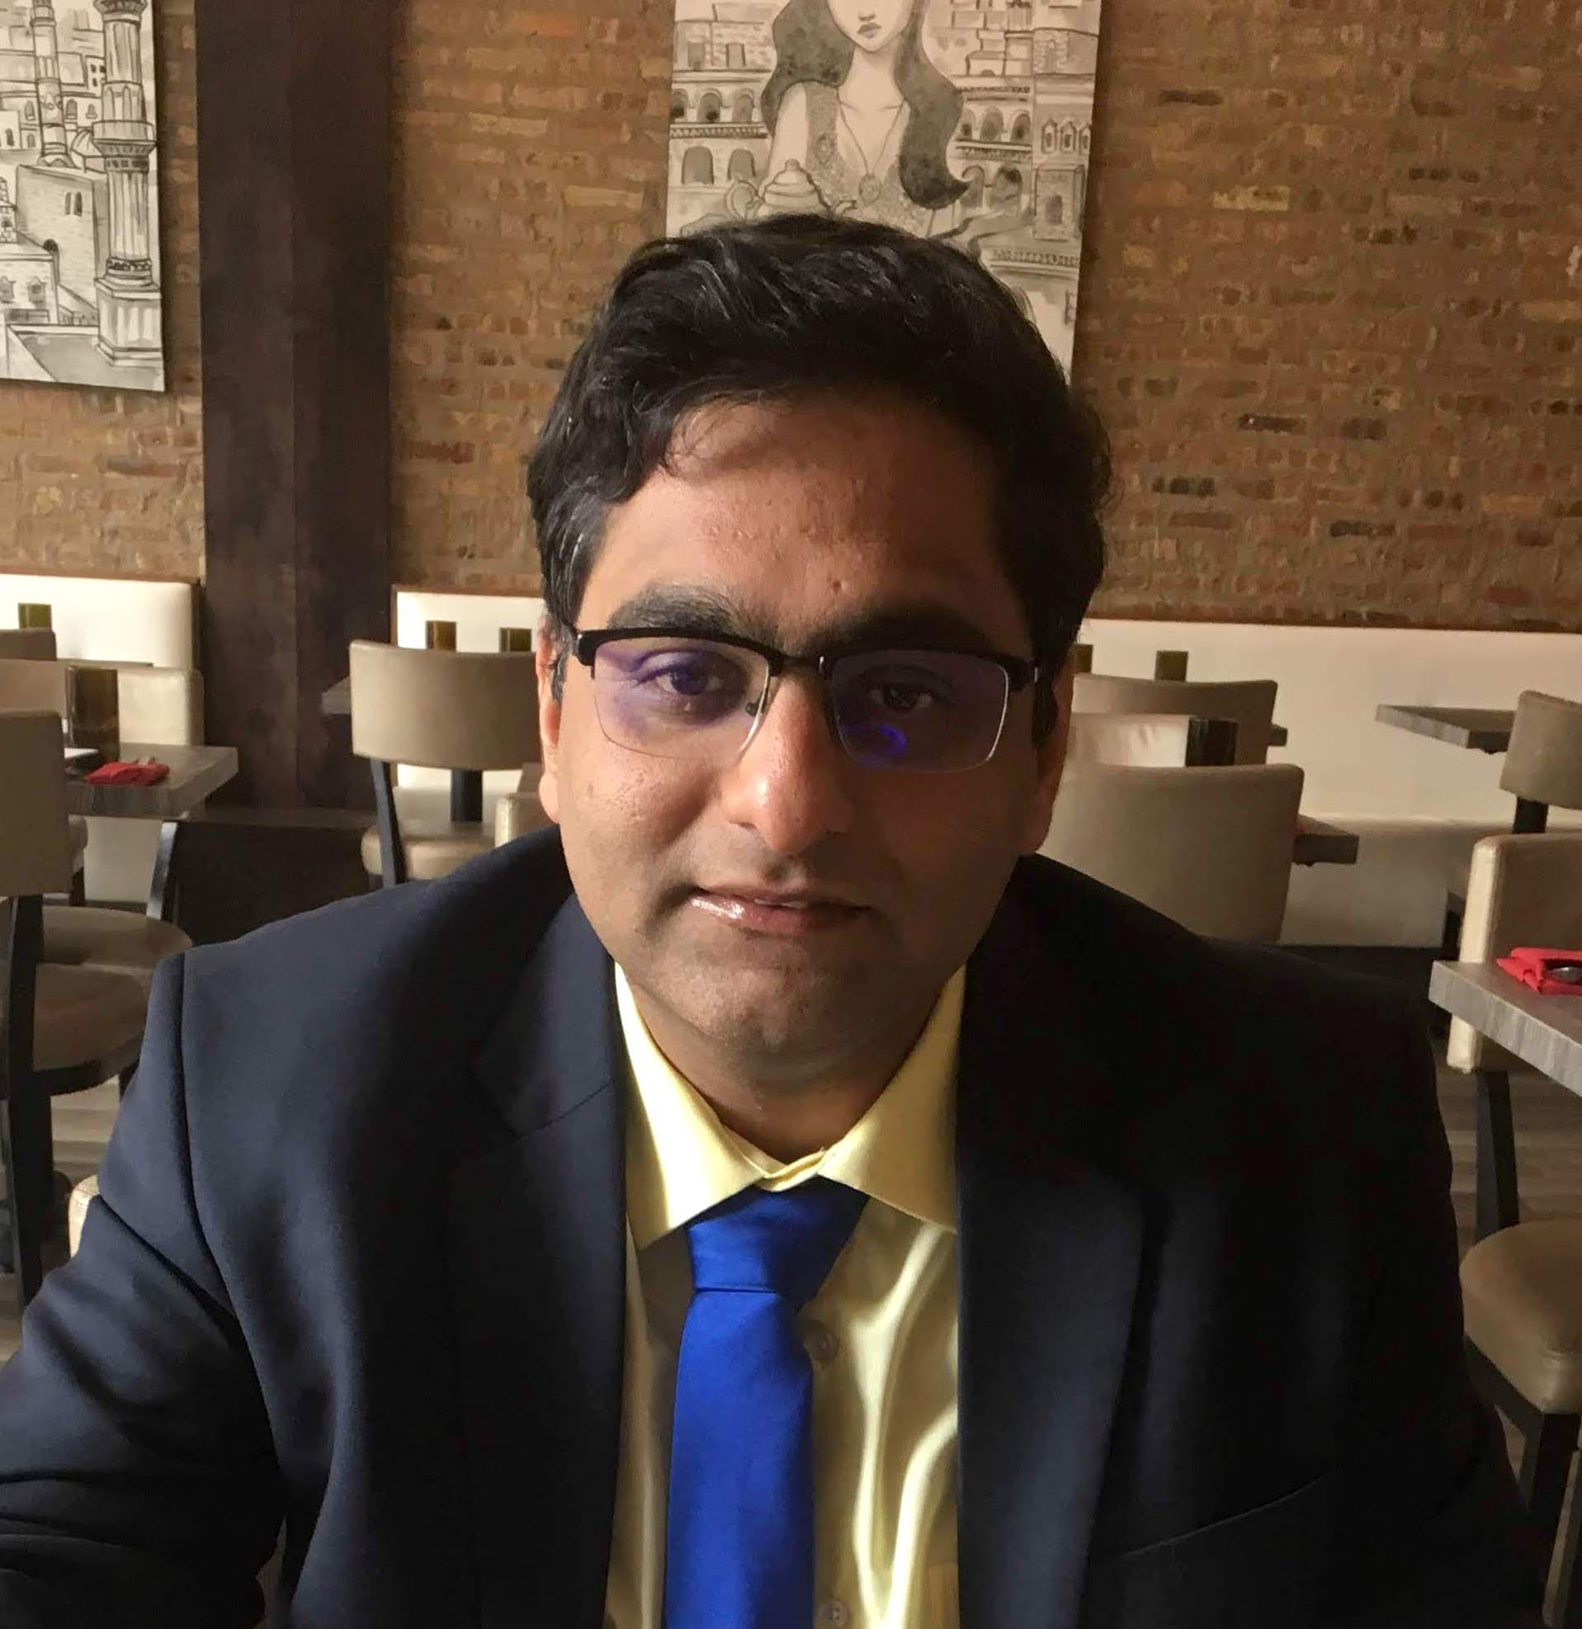
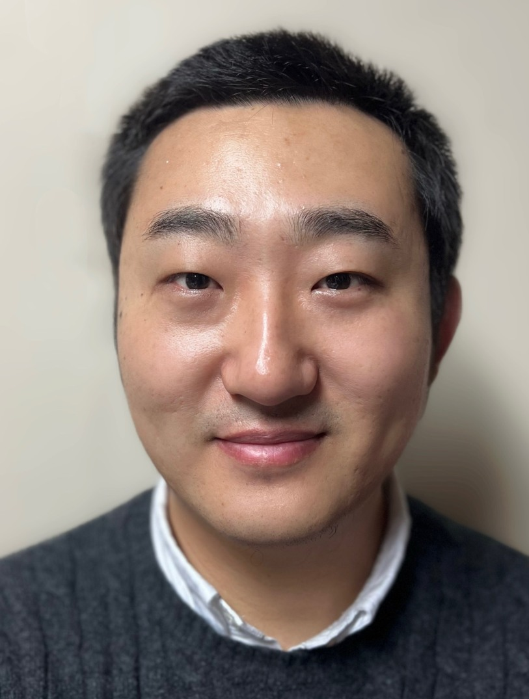
MAPPS Team: Featured researchers
Jason Gantenberg, PhD
Research Scientist, Department of Health Services, Policy & Practice; Assistant Professor of Epidemiology
Aditya Khanna, PhD
Computational Epidemiologist and Statistician, Department of Behavioral and Social Science
Guixing Wei, PhD
Senior GIS Developer, Spatial Structures in the Social Sciences (S4)

Slide 41
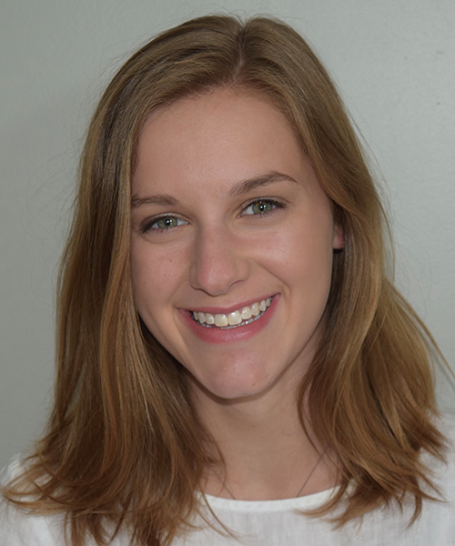
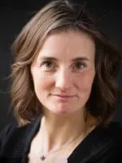
MAPPS Team: Workshop organizing committee
Peyton Luiz
MAPPS Project Manager
Betsy Stubblefield Loucks, ScM, MBA
Associate Director of Research Strategy, Office of the Vice President of Research

Slide 42
MAPPS Team: Knowledge keepers
Josi DeHaven, MPH, BSN, RN, CCM
Scott Griffy, PhD student in computer science
Jorge Ledesma, PhD student in epidemiology
Aquielle Person, RA with the Pandemic Center at Brown University
Maria Pieruccini, MPH Student
Gage Reitzel, MPH student
Leah Rosenbloom, PhD student in computer science
Qiuhong (Anna) Wei, BS/MS student in computer science
Marta Wilson-Barthes, School of Public Health Project Coordinator
Isabella Zangari, undergraduate student at Colgate University
Mohammed Akel, Undergraduate computer science and public health student

Slide 43
Questions? Comments? Concerns?

